Slide 1
Advance Condition Based Predictive Maintenance of
Electric Motors in Ships
Kibichii Kieran
Supervisors : Dr Oyunge Benson.
: Dr Gerald J. Odhiambo.
December, 2022

Slide 2
Understanding the problem
Item 1
Item 2
Item 3
Downtime: shipping is the lifeblood of the global economy and operational disruptions are not only costly for shipping companies but also other key players in the supply chain.
High maintenance cost. This has been a challenge due to reduce profit margins experienced during maintenance of onboard equipment.
After the warranty period motors can still be useful and there is no necessity to replace the undamaged parts.

Slide 3
Target audience
This project will be beneficial to the following entities in the shipping industry:
Owners
Classification Societies
Surveyors
Engineers
Manufacturers

Slide 4
Industry Trends
Observations of industry practices show that past industry experience in reliability is heavily based on trial-and-error test procedures. Most of the reliability research in industry still focuses on two distinct periods of the product life: the warranty period, where most of the failures are due to product malfunctions or quality related problems, and wear-out period, where the failures are due excessive wear and use.
Client Implications:
Increased cost of operations
Downtime that results in adverse effects throughout the “goods” supply chain

Slide 5
Project objective:
To monitor the health of ship motors improving reliability and preventing downtime
in ships.

Slide 6
JUSTIFICATION
Electric motors serve as a critical component for any facility. They are prone to failures which may disrupt business operations and decrease productivity.
Traditionally, maintenance involves routine inspection and repair done manually.

Slide 7
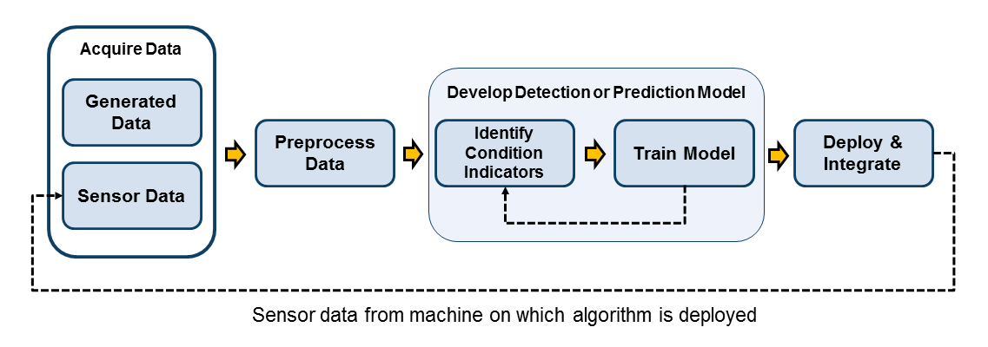
How can This be achieved?
Methodology

Slide 8
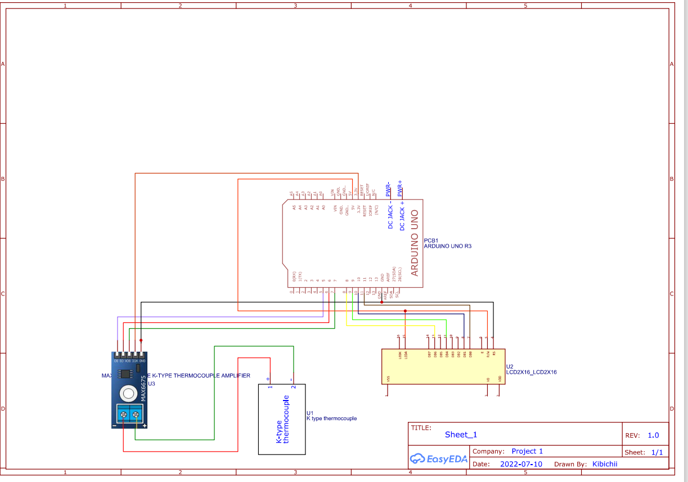

Slide 9
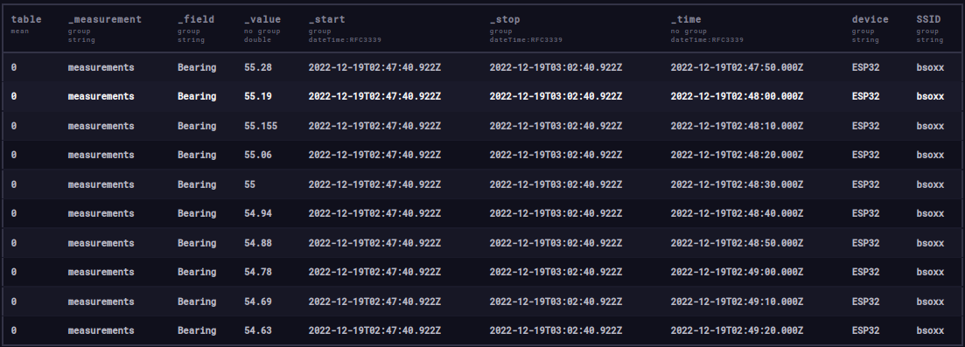
Data logs

Slide 10
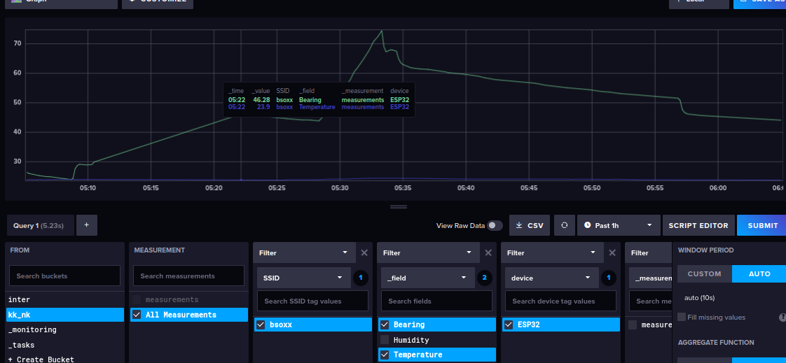
Data Querying

Slide 11
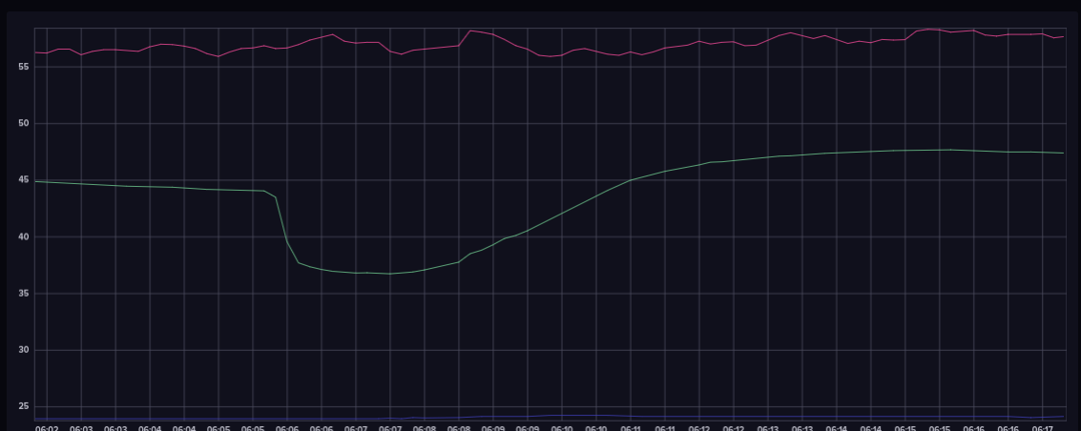
Normal motor Benchmark

Slide 12
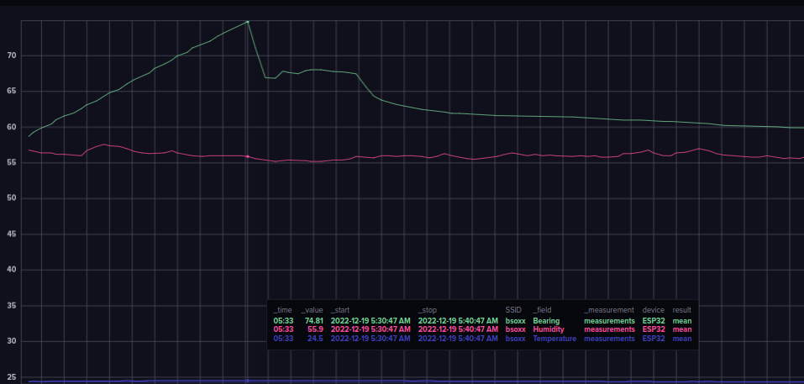
Motor 1 and 3 comparison
motor shutdown

Slide 13
OUTCOMES
Outcome 1
A functional motor health monitoring device has been developed
Outcome 2
Predictive maintenance algorithm has been achieved that can notify of anomalies
Outcome 3
The multiple sensor module has been achieved that can synonymously monitor multiple paramaters
Outcome 4
Electric system motor performance and efficiency has been optimized using insights from real-time data collected.

Slide 14
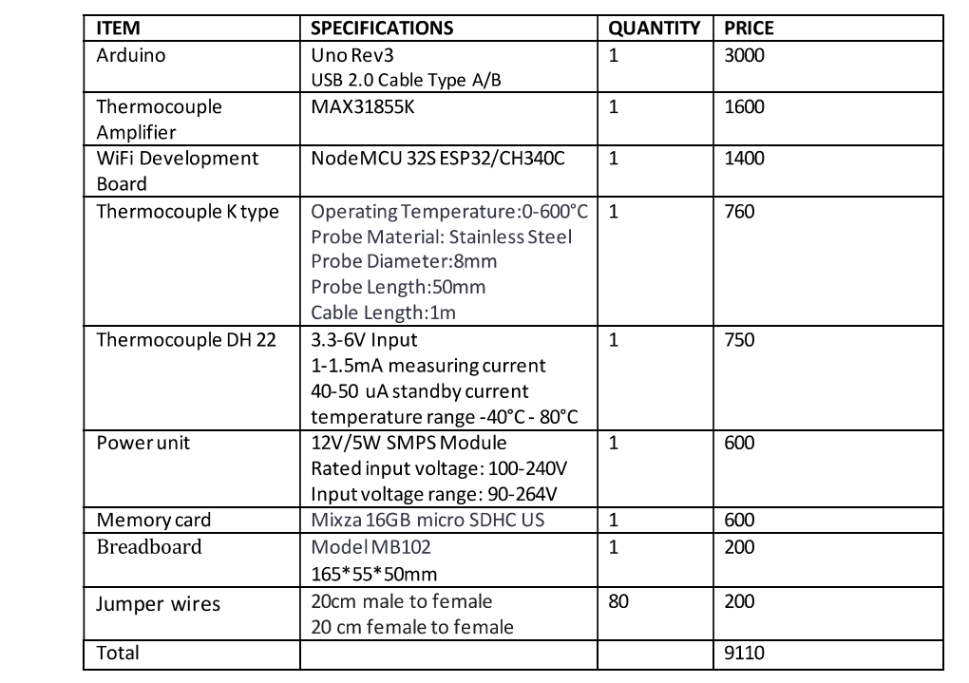

Slide 15
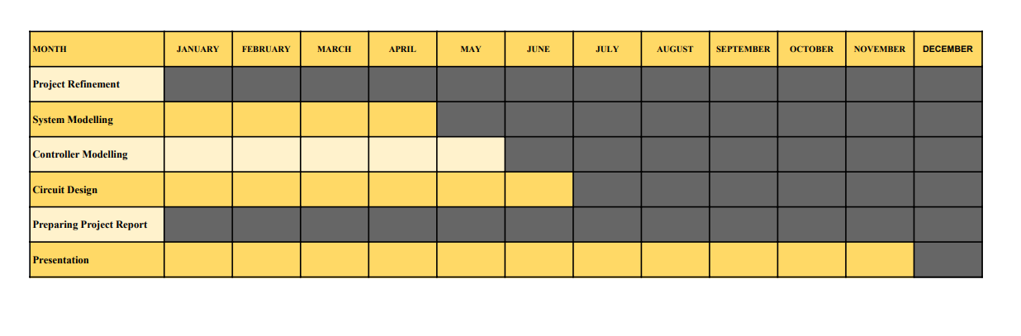
WORK PLAN

